Slide 1
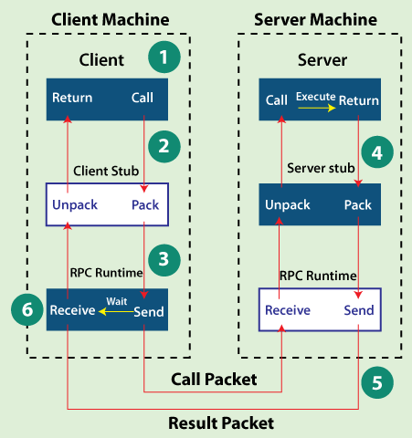
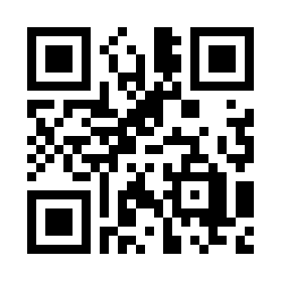
Lab 01 - Key-Value Store Using RPC
https://bit.ly/47fc0TO

